Slide 1
`@2
2023 Michigan Moose Association
Membership Workshop

Slide 2
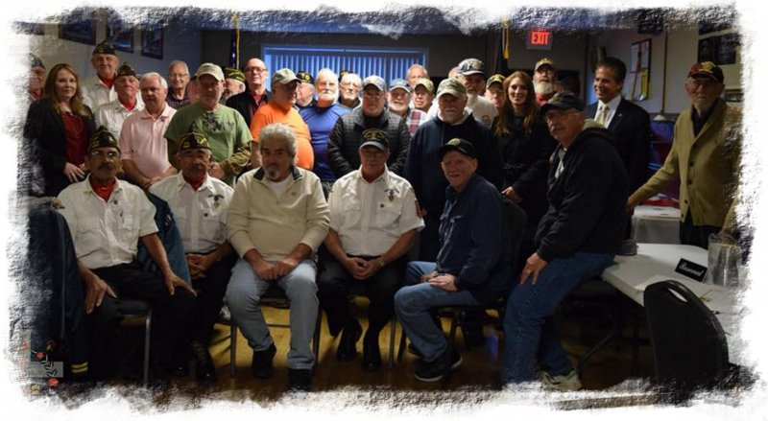
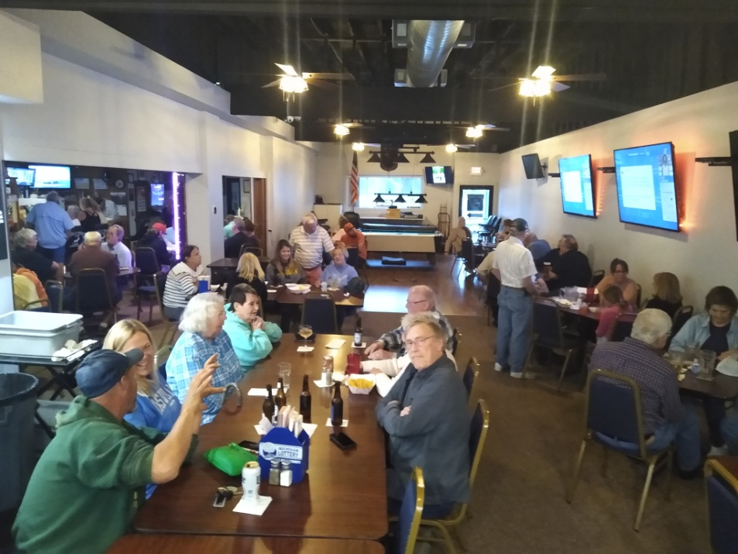
`@2
WHO ARE OUR MEMBERS?
Generations of Families
Valued Veterans
Board of Officers
WOTM
Community Officials
Teachers
Medical Providers
Skilled Trades
Service Industry
...and so many more.

Slide 3
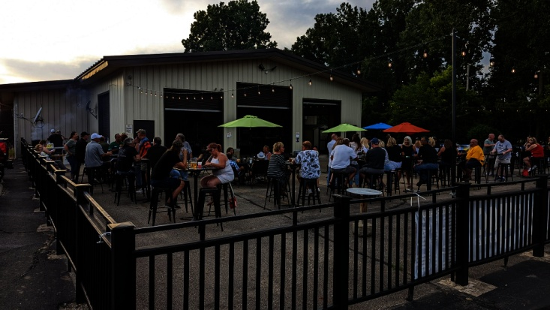
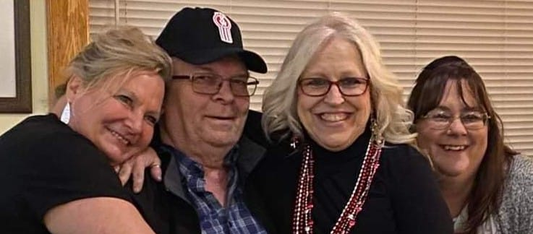
`@2
HOW DID THEY BECOME MEMBERS?
HOW DO WE KEEP THEM?

Slide 4
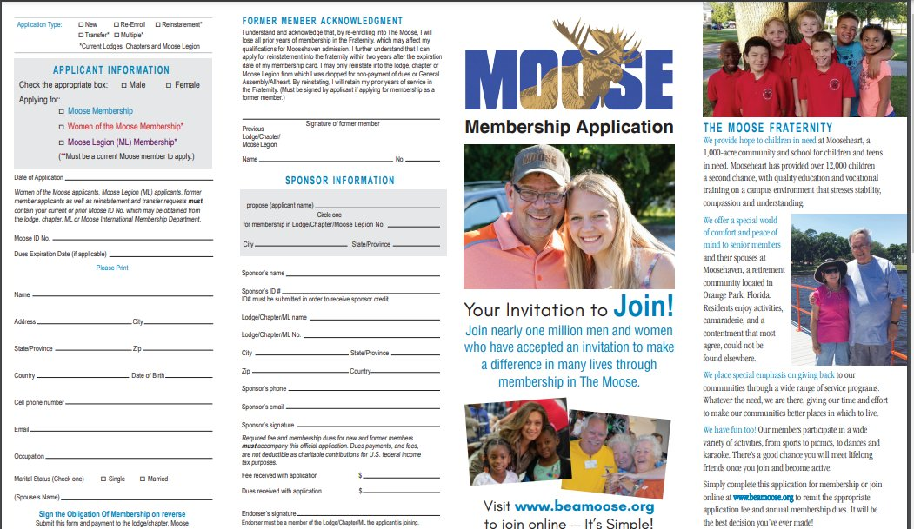
`@2
ARE WE FILLING OUT APPLICATION PROPERLY?

Slide 5
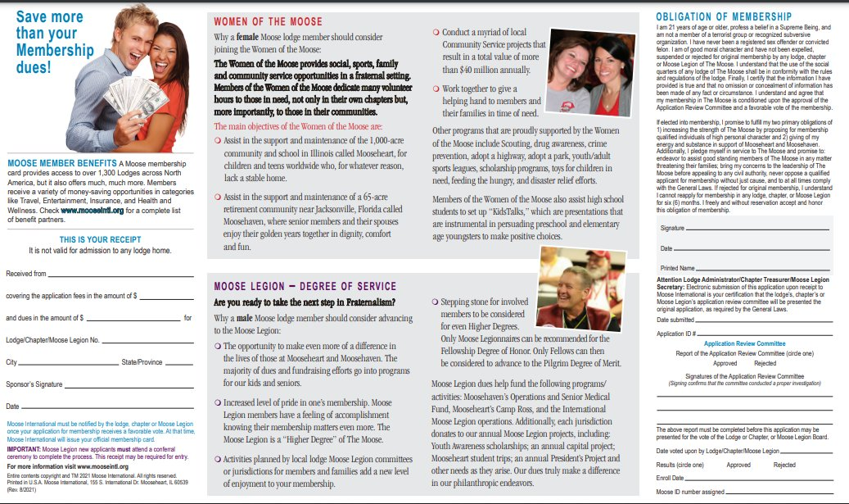
`@2
SIGNED BY APPLICANT & SPONSOR

Slide 6
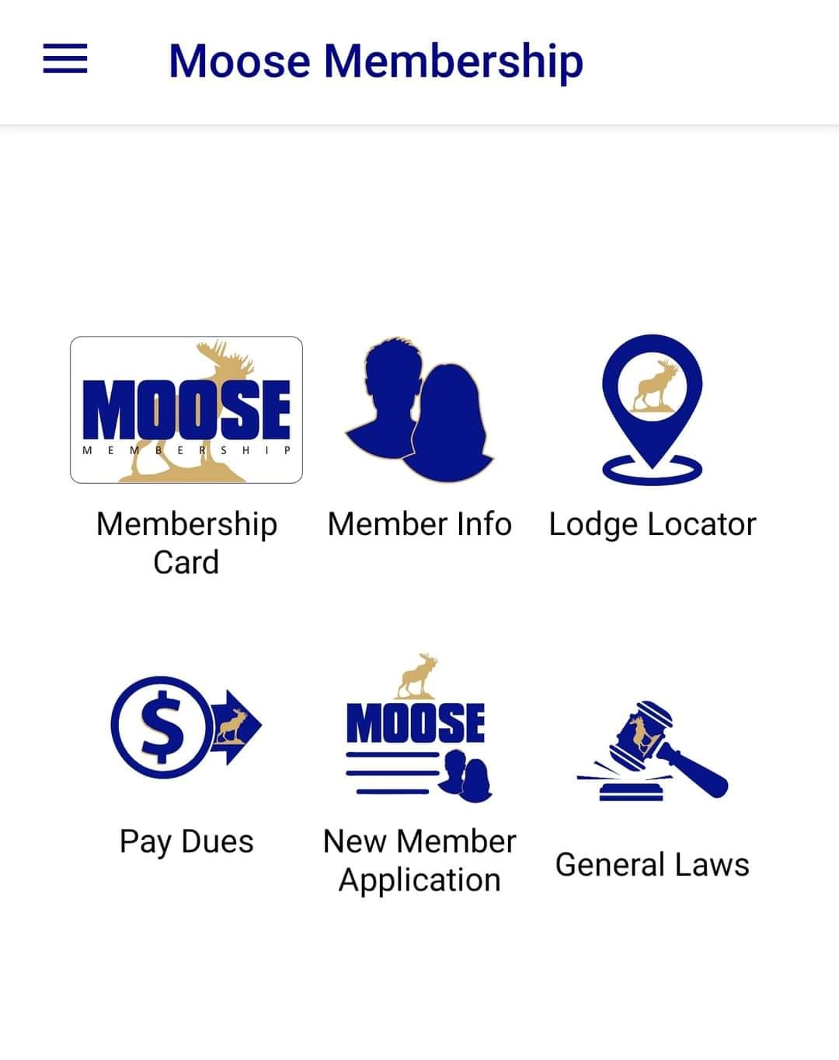
`@2
NEW - MOOSE MEMBERSHIP MOBILE APP
Available on both
Google Play
Apple Store

Slide 7
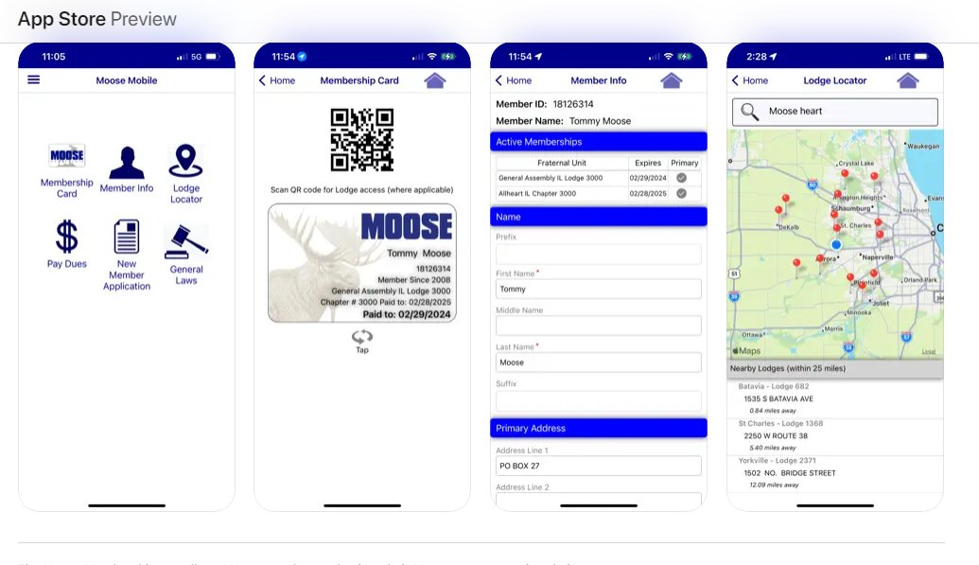
`@2
ALL THINGS MOOSE AT YOUR FINGERTIPS!

Slide 8
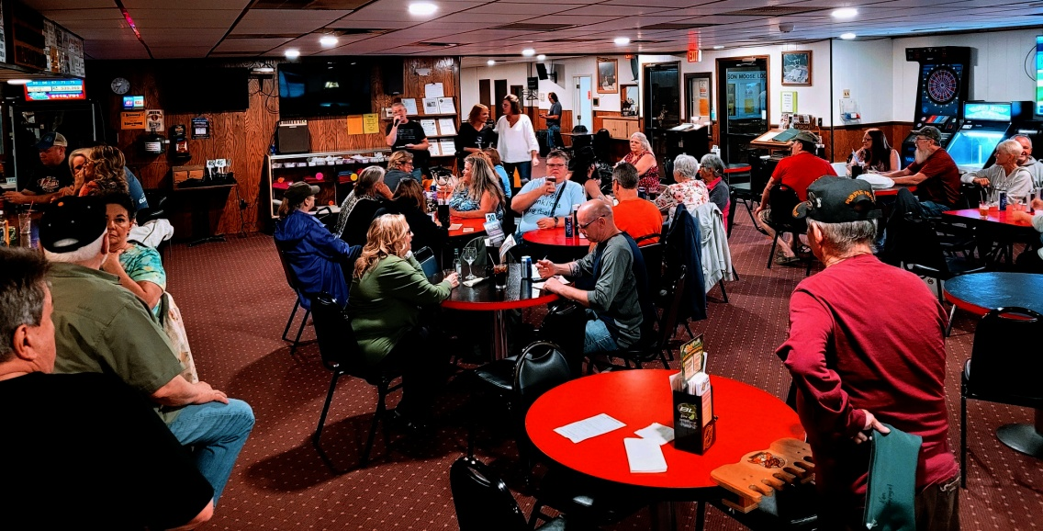
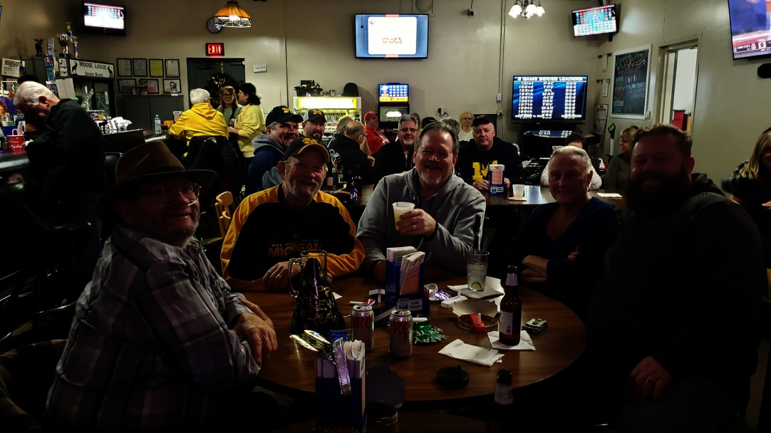
`@2
How are applications to your lodge handled?
REVIEW
COMMITTEE

Slide 9
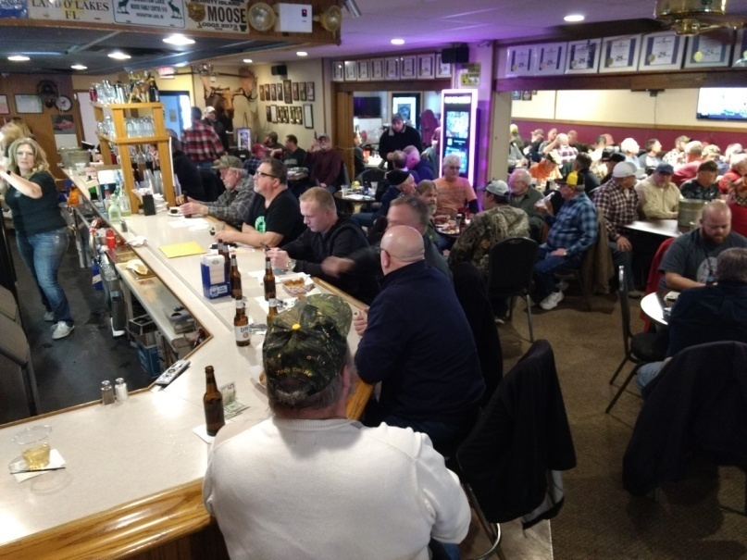
`@2
“The feeling of belonging to an organization with a higher purpose far outweighs any other reason a member might choose to join.”
Mike Rios
Director of Membership

Slide 10
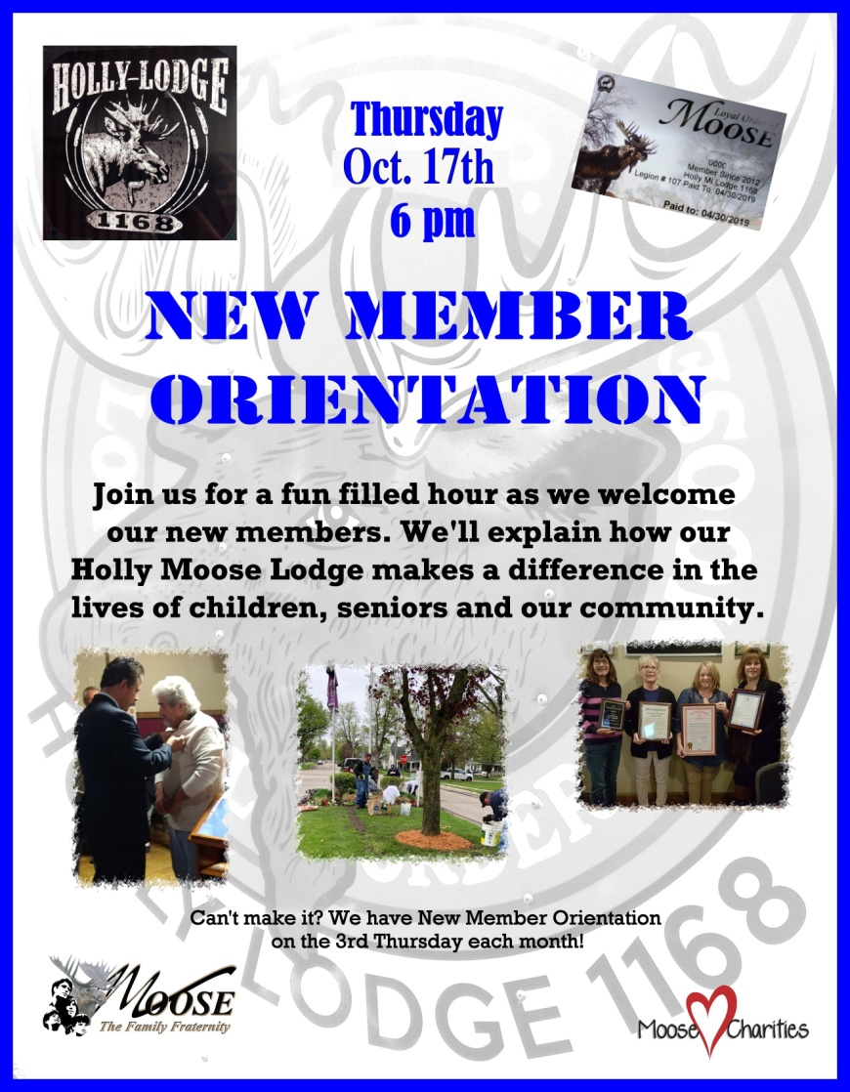
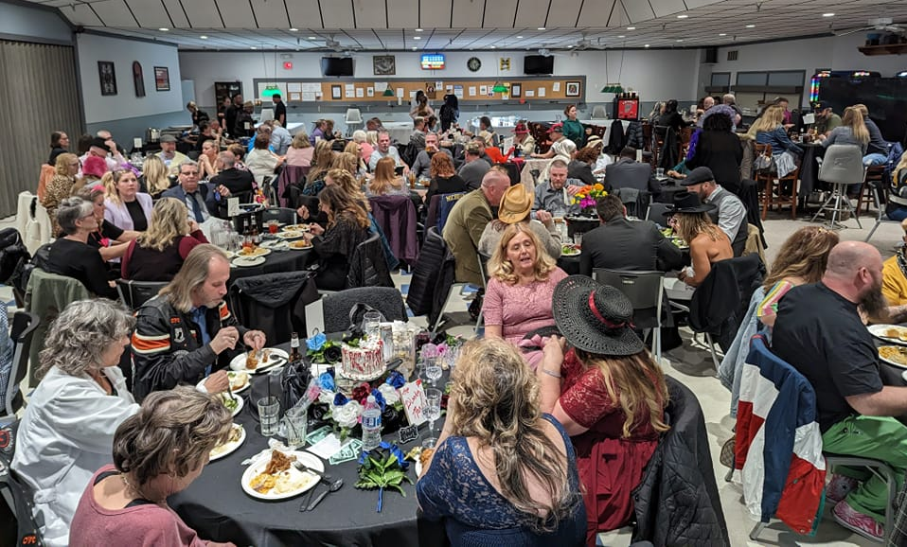
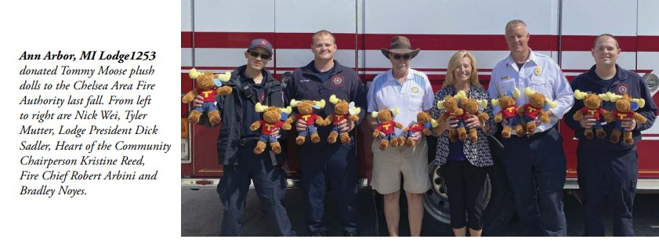
`@2
NEW MEMBER ORIENTATION

Slide 11
`@2
Orientations mandatory.
What does YOUR lodge do?
History of the lodge.
Ask them to bring family members or friend.
Show the New Member Orientation video.
Show the Enrollment video.
Make them feel welcome.
Introduce them to others around lodge!

Slide 12
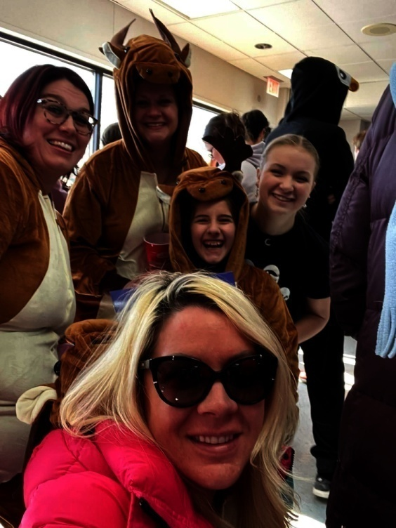
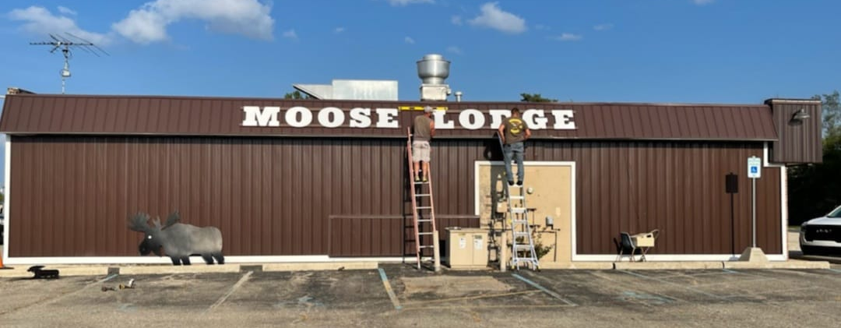
`@2
Explain lodge activities
Ask for volunteers
Discuss current Membership campaigns

Slide 13
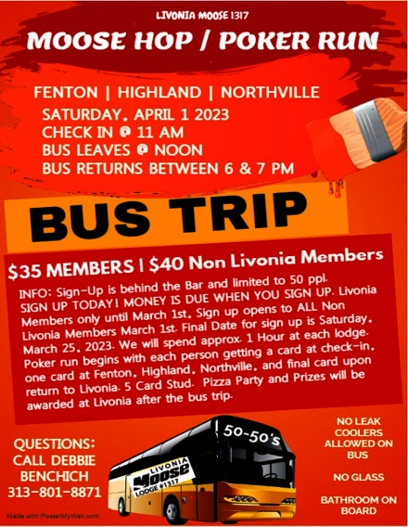
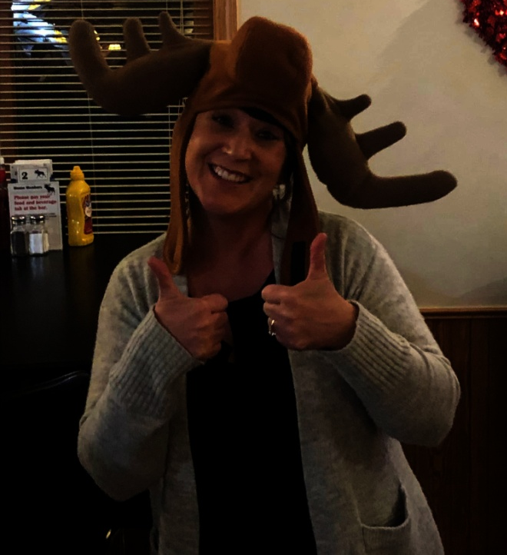
`@2
WHAT ARE YOUR LODGE CAMPAIGNS?
SHORT TERM –
Contest for 1 year paid dues
Free Friday dinner
Tie to an activity – free bus trip ticket
LONG TERM –
* No application fee
* Sign 7 receive lodge jacket
* What else?

Slide 14
`@2

Slide 15
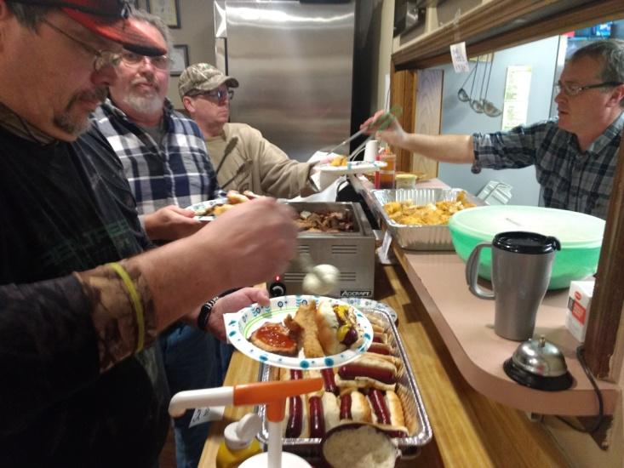
`@2
RETENTION
Discuss the reasons we are Moose Members
Why are they not renewing? Ask!
ENROLL GOOD POTENTIAL CANDIDATES!
Explain why their dues are important,
Involve them more in activities.
RUN EXPIRED LIST each month from LCL
Make phone calls.
Ask their SPONSOR!
Reward EXISTING members for
bringing back an expired member!

Slide 16
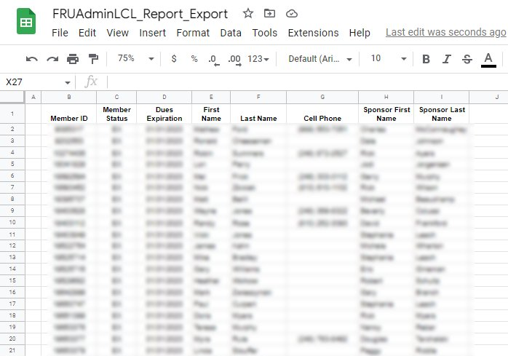
`@2
USE THE LIST
MAKE THE CALLS CALL THE SPONSOR

Slide 17
`@2

Slide 18
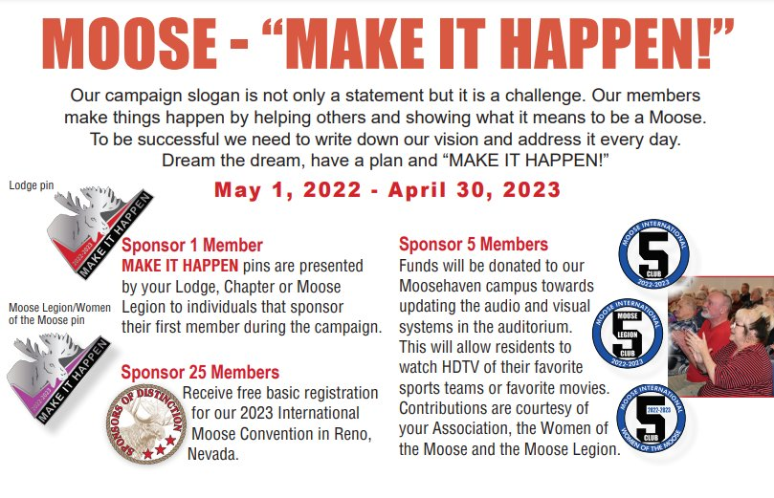
`@2

Slide 19
`@2
Thank you for
all you do!

